Slide 1
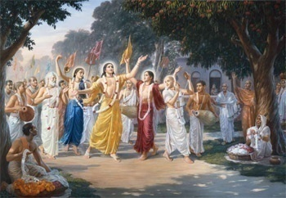
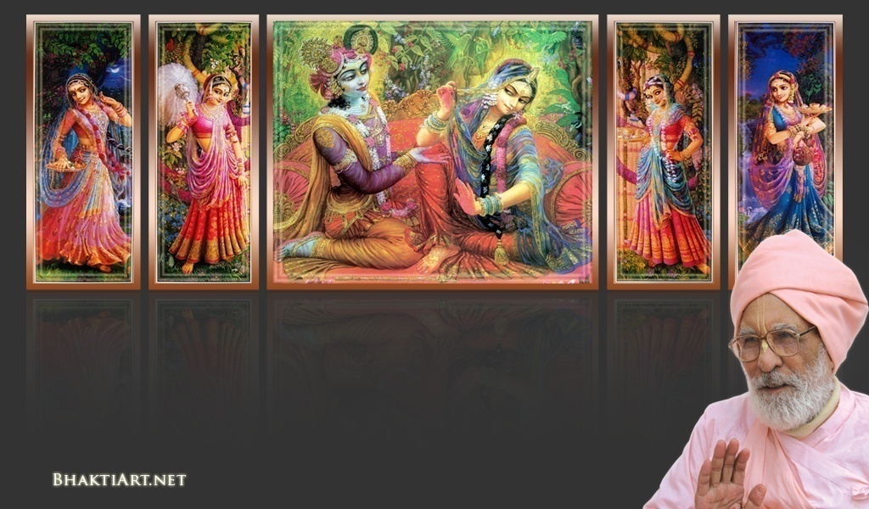
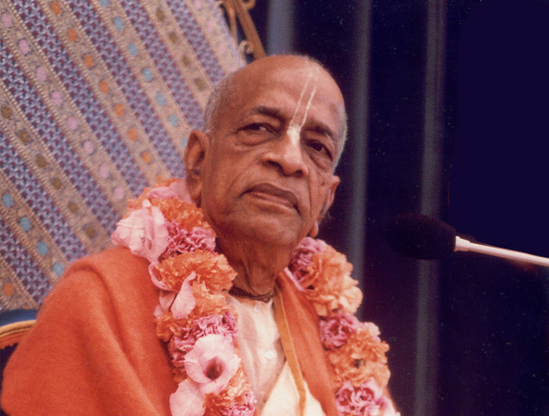
Sri Krsna Caitanya Prabhu Nityananda
Sri Advaita Gadadara Srivasadi
Gaura Bhakta Vrinda
Week 365
Nov 06
2015
Hare Krsna Hare Krsna
Krsna Krsna Hare Hare
Hare Rama Hare Rama
Rama Rama Hare Hare
Gokul Bhajan & Vedic Studies
North Carolina, USA
Notes:
Om Ajnana timirandhasya, jnananjana salakaya
Caksur unmimiltam yena, tasmai sri gurave namah
Namah om vishnu padaya, radhikayah priyatmane
Sri-srimad bhaktivedanta, narayana iti namine
Narayanam gurum vande, Saranam bhakta bāndhavam
Gaura manobhishtam poornam, Radha dāsyam pradāyakam
Rupānugācarya varyam, Rupa manjari preshtakam
Patita pāvana bāndhava, Yugācarya nārāyanam
Sri krishna lila kathane sudaksham, Audarya-madhurya gunais ca yuktam
Varam varenyam purusham mahantam, Narayanam tvam sirasa namami
He krishna karuna sindho, dina bandho jagat pate
Gopesha gopika kanta, radha kanta namo ‘stu te
Tapta kancana gaurangi, radhe vrindavaneshvari
vrsabhanu sute devi, pranamami hari priye
bhajami radham aravinda netram, smarami radham madhurasmi-tasyam
vadami radham karuna bharardram, tato mam anyasti gatir na kapi
bhaktya vihina aparadha-laksaih, ksiptas ca kamadi-taranga-madhye krpamayi tvam saranam prapanna, vrnde namas te caranaravindam
--------------------------
First of all, I pay my koti dandavat pranams to my diksha guru Om vishnupada rupanuga acharya Sri Sri Bhakti Vedanta Narayana Goswami maharaja. My koti dandavat pranams to Sri Sri Bhakti Vedanta Swami Prabhupada, and guru varga.
My humble pranams at the lotus feet of all assembled devotees, vaishnavas and vaishnavis..

Slide 2
Gokul Bhajan - We celebrate a great milestone!
Today we have reached the 365th week
We started GBVS in Jan, 2007
Imagine we conduct every day for a full year – 365 days!
By the will of Krishna, families coming in, children graduating..
Thank you for your support!

Slide 3
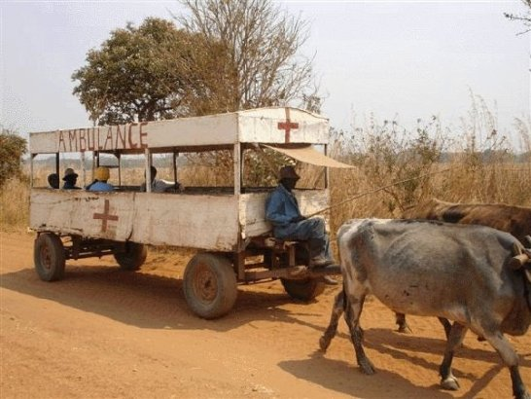
Only In India!
“ Emergency? Get in quick! Surely we will reach by end of this month itself..!”

Slide 4
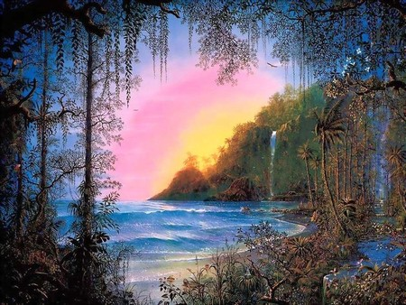
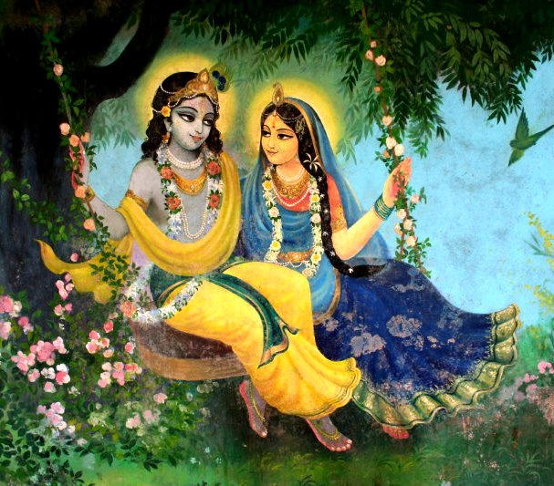
Jaya Rādha Mādhava
Jaya Kunja Vihārī
Jaya Gopī Jana Vallabha
Jaya Giri Vara Dhārī ... (Jaya)
Yaśodā Nandana Vraja Jana Ranjana
Yamunā tīra Vana Cāri ... (Jaya)
[ Hare Krishna Hare Krishna
Krishna Krishna Hare Hare
Hare Rāma Hare Rāma
Rāma Rāma Hare Hare ]

Slide 5
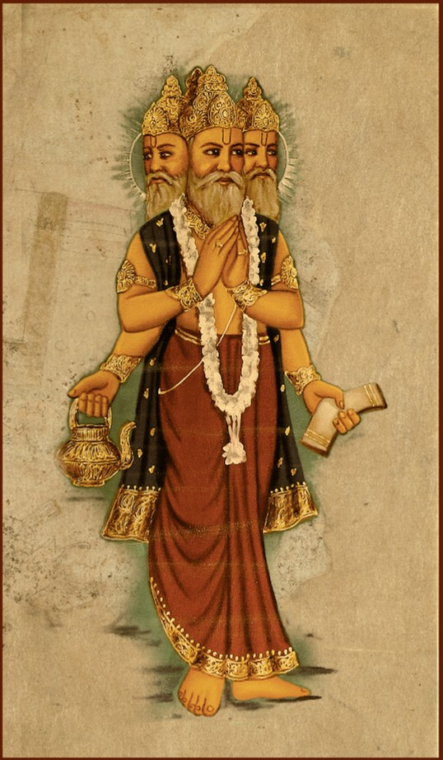
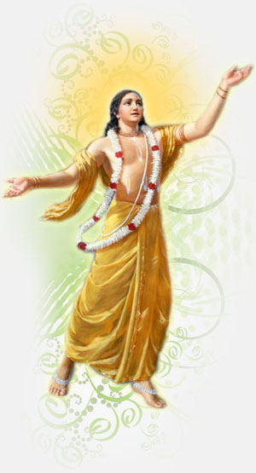
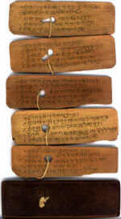
Slides Video
Brahma Samhita

Slide 6
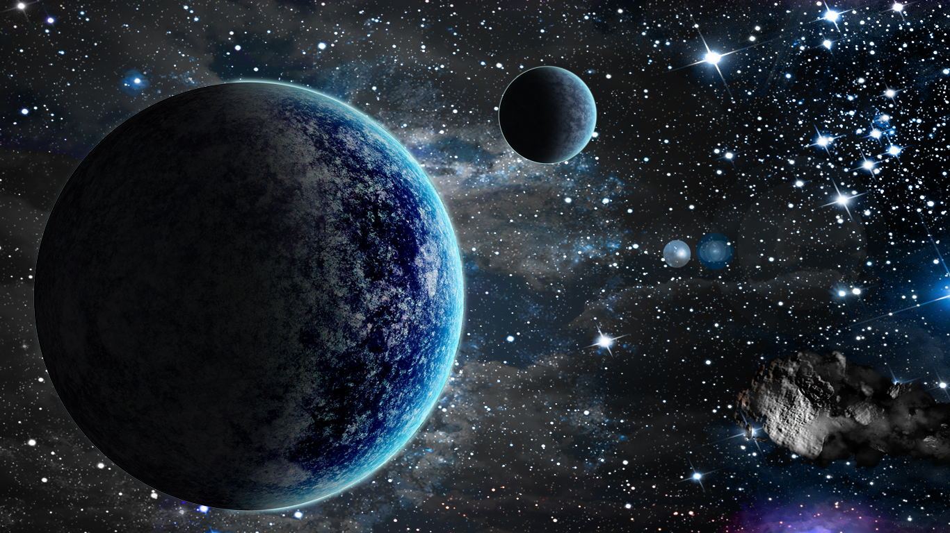
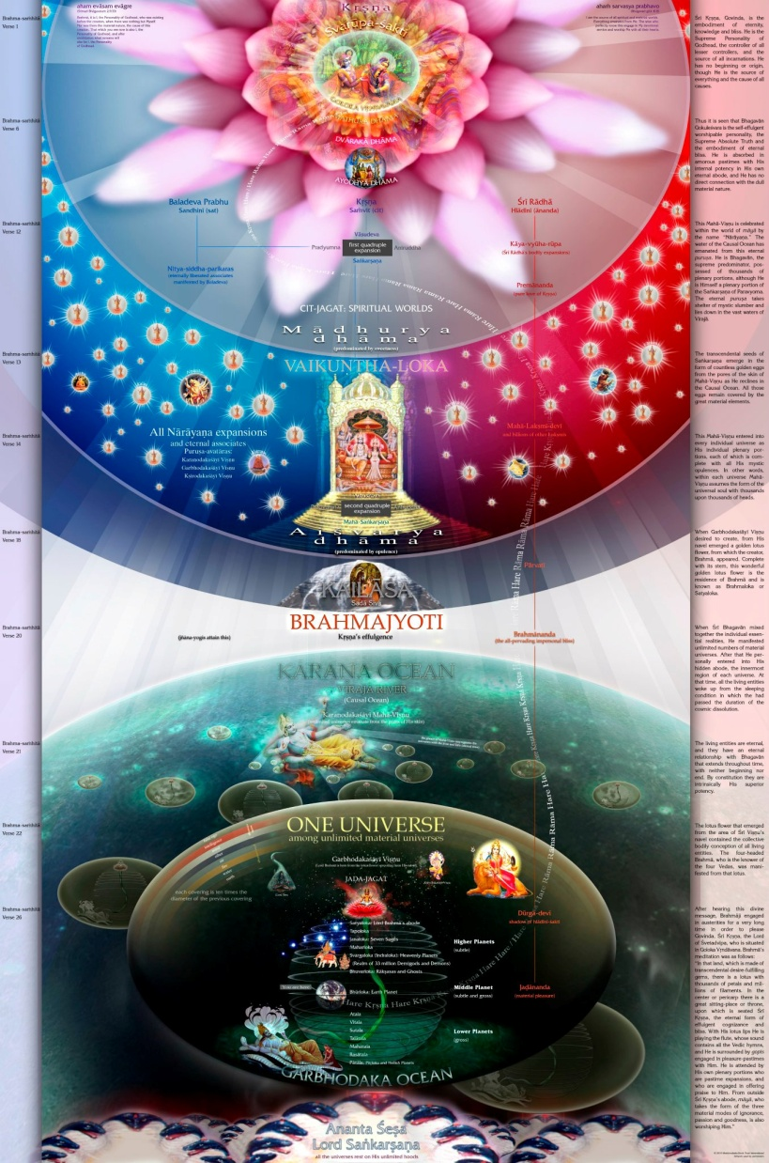
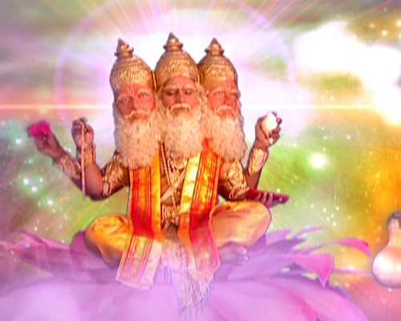
Sri Brahma Samhita: Verse-38

Slide 7
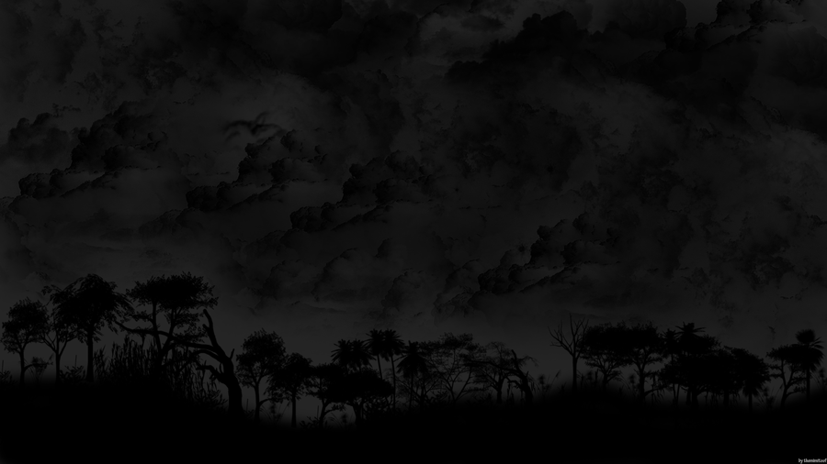
BS - 38
premāñjana-cchurita-bhakti-vilocanena
santaḥ sadaiva hṛdayeṣu vilokayanti
yaḿ śyāmasundaram acintya-guṇa-svarūpaḿ
govindam ādi-puruṣaḿ tam ahaḿ bhajāmi
I worship Govinda, the primeval Lord, who is Syama Sundara, Krishna Himself with inconceivable innumerable attributes, whom the pure devotees see in their heart of hearts with the eye of devotion tinged with the salve of love

Slide 8
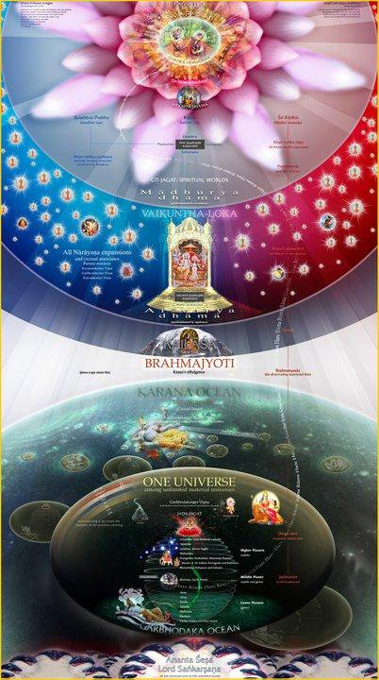
prema – of divine love
añjana – with the salve
cchurita - tinged
bhakti - of devotion
vilocanena – with the eye
santaḥ - the devotees
sada – always
eva - indeed
hṛdayeṣu – in their hearts
vilokayanti - see

Slide 9
yaḿ - whom
śyāma - dark blue
sundaram - beautiful
acintya - inconceivable
guṇa - with attribues
svarūpaḿ - natural form
govindam - Lord Govinda (Krsna)
ādi - original
puruṣaḿ - person
tam - Him
ahaḿ - I
bhajāmi - worship

Slide 10
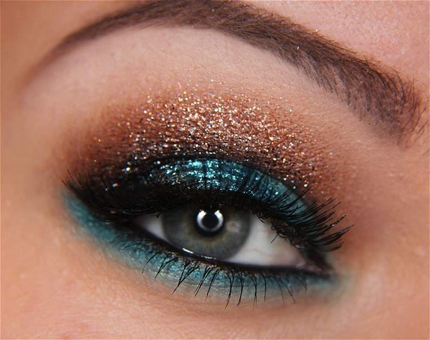
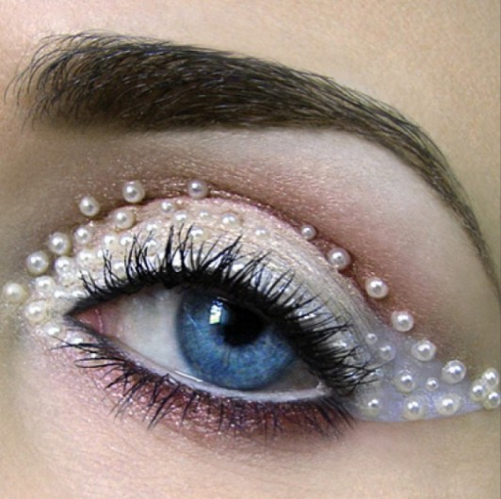
añjana-cchurita

Slide 11
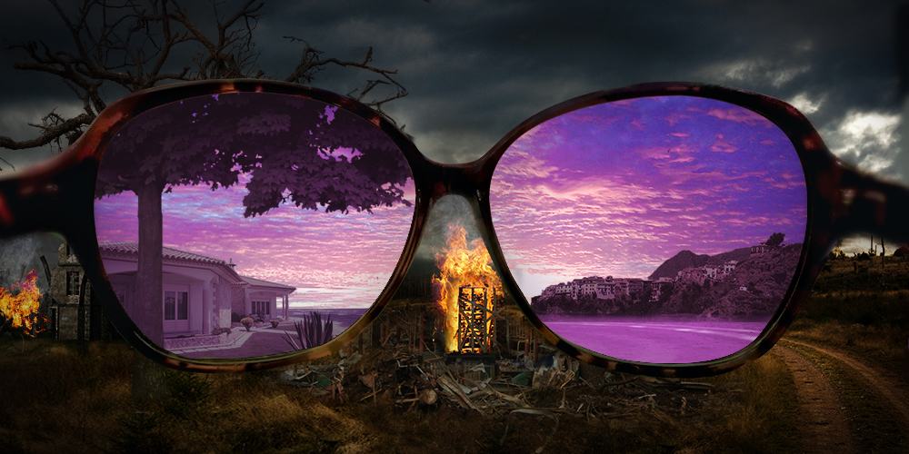

Slide 13
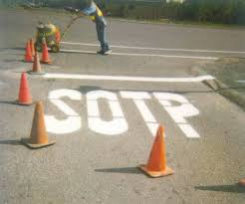
Notes:
This worker who painted must have come from that Child Bear place!

Slide 14
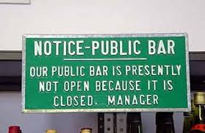
Notes:
Well, looks like the manager was also drunk!

Slide 15
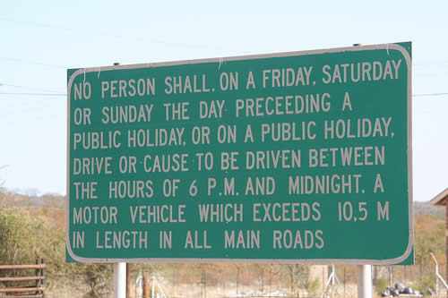
Notes:
Well, if you are not drunk, you can surely understand !

Slide 16
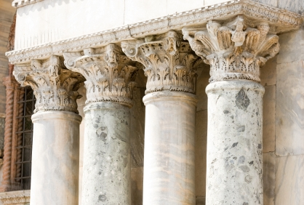
What are the 4 Pillars of Krishna Consciousness?
1
2
3
4

Slide 17
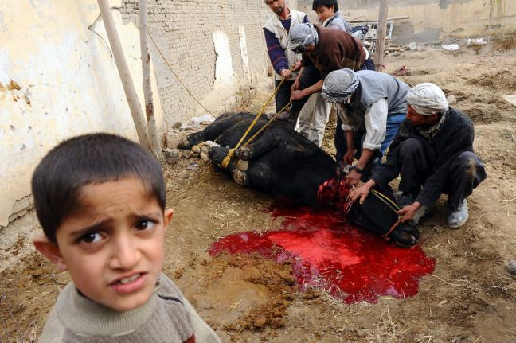
1. No Meat Eating

Slide 18
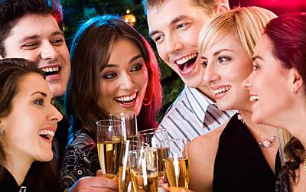
2. No Intoxication

Slide 19
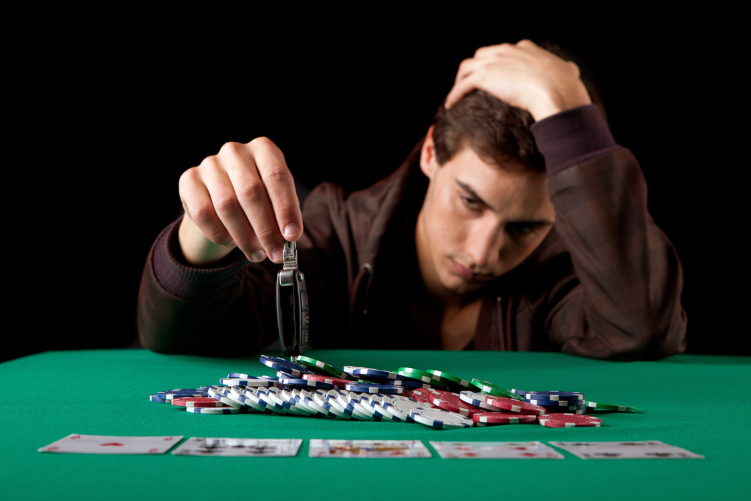
3. No Gambling

Slide 20
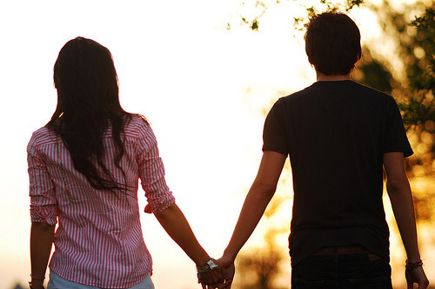
4. No Un-marital Close Relationship

Slide 21
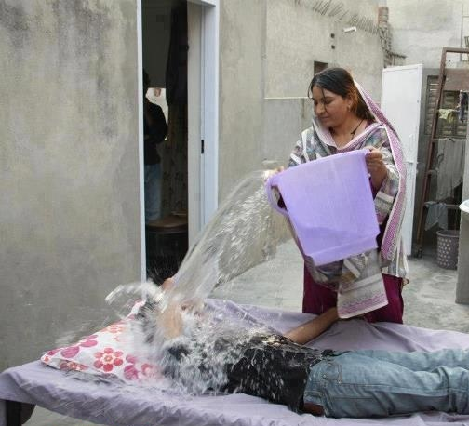
Another one by GBVS..
Do not sleep too much!
Get up early!

Slide 22
Notes:
We do not see Krishna all the time, but He is always seeing us!
He is in everyone’s heart.

Slide 23
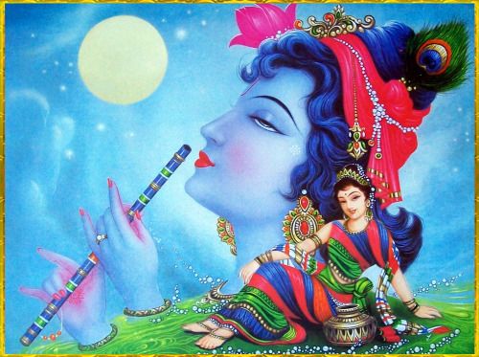
Notes:
But devotees see Krishna with their divine eyes – not physical eye.

Slide 24
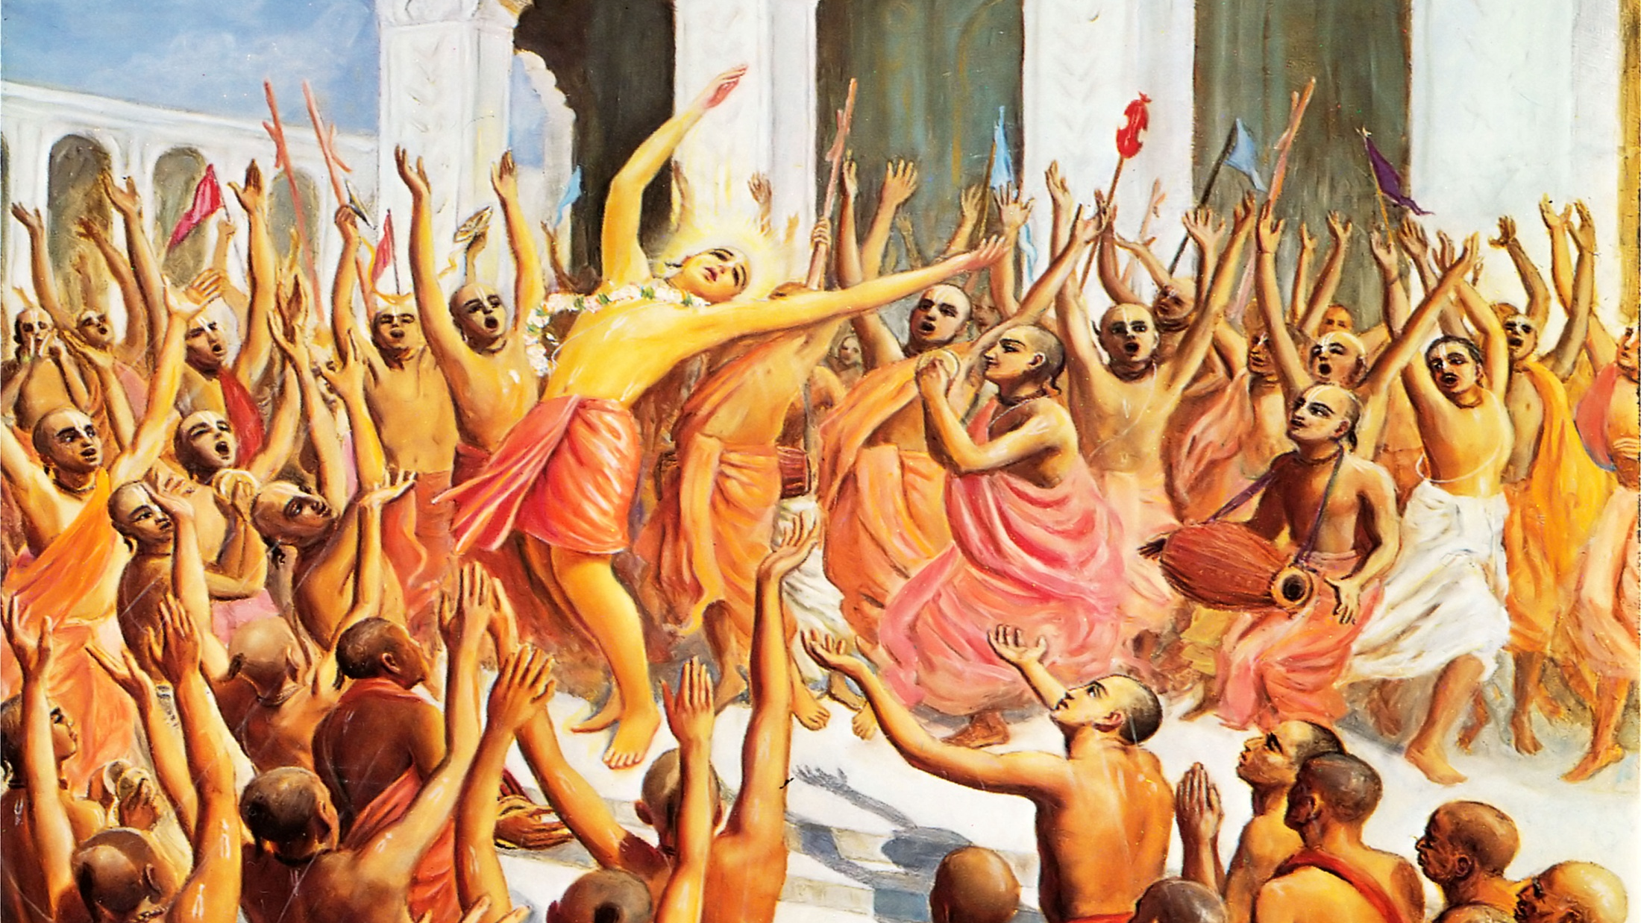
In fact, Bhaktas are also like Drunk People!
Notes:
Lord Sri Caitanya came to show this very clearly.
He was distributing this kind of very high Bhakti to every one!
He came with His associates from Svetadvipa, a part of Goloka to teach as how we should be living and become a bhakta of Lord Krishna.

Slide 25
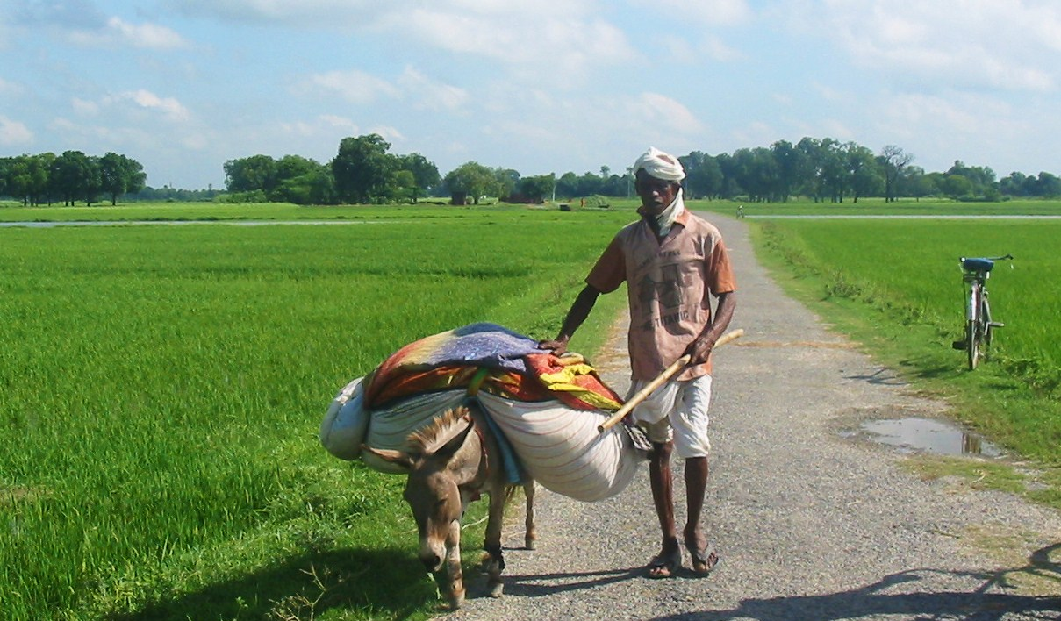
Notes:
Lord Caitanya used to travel to all the places..
Once He happened to give some mercy to a washer man...

Slide 26
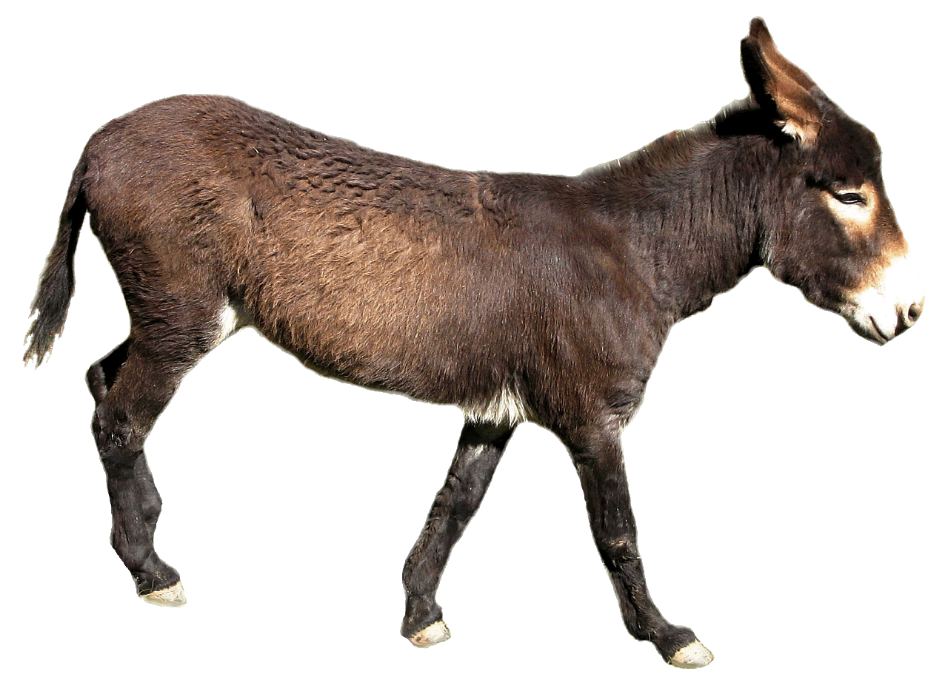
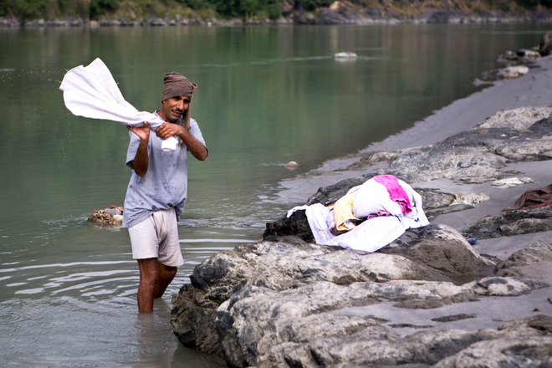
Notes:
The washer man used to bring the loads of dirty clothes to the nearby river bank to wash..
His wife later brings him the food for lunch.

Slide 27
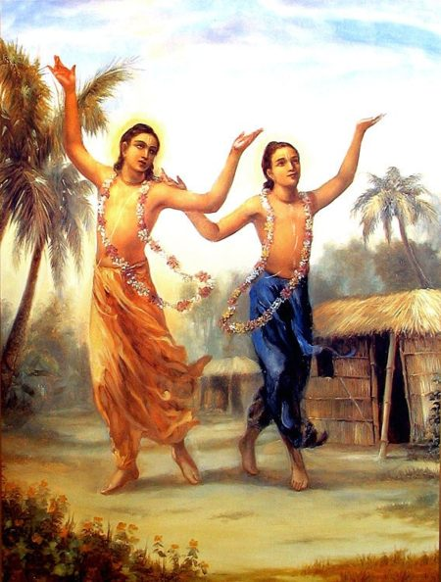
Notes:
On a day morning, both Lord Caitanya and Lord Nityananda happened to be passing by..
When they rested under a tree, they saw this washer man and felt very pitful...
They both decided to give some mercy..
They approached,”Oh, you look like working very hard..”
Washerman looked,”Oh you sannyasis don’t have any work.. Not me..”
“We want you to chant the holy mantra!’
“Now? You must be kidding! Why? What good does it bring? Go away!”
“Please chant “ “No way!”
‘At least once.. Otherwise we won’t go away!’
Ok, what to chant? hare what?
Hare Krsna, Hare Krsna,.....
That was it..

Slide 28
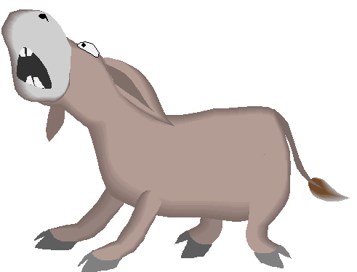
Notes:
It was like a small fire caught in...
and he started dancing!
he was like a mad person.. or like a drunkard...
Seeing him dancing so mad, the donkey also started dancing!
And singing and singing!
Lord Caitanya and Lord Nityananda smiled and left..
But his dancing with his donkey was going on.. and on..

Slide 29
Notes:
His wife came with the lunch...
Noticed that all the clothes are lying around in pile, and her husband dancing!!
And dancing with his donkey!
She got panic... She went near and got scared to even touch..
She though that her husband has been possessed by a GHOST..
She ran to the village, told the problem and brought some people.
People with strength tried to catch him..
But whoever touched him also started to dance!
She was now more panic.
‘Oh, this is a very powerful ghost.. Let me bring more people..”

Slide 30
Notes:
Eventually the entire village people came..
And every one was dancing..
‘Hari Bol! Hari Bol! hare Krishna hare Krishna...”
there was even rain.. no one cared..
She was crying and weeping...”What can I do, What can I do..”
Towards evening, slowly the dancing came to stop..
They were wondering what was happening..
Then the washer man told about the two Sanyasis, who asked him to chant...!

Slide 31
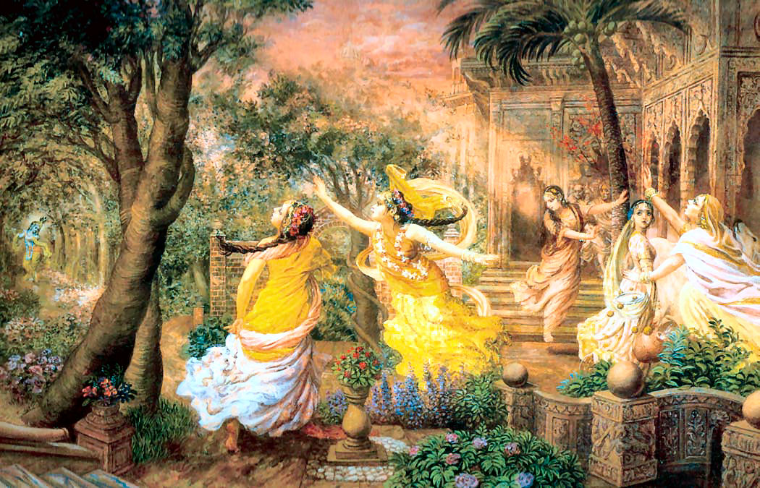
Notes:
Same thing with the flute of Krishna!
When he sings, every one and the whole Brahmandas become like mad and dancing as drunkards..
But kind of madness is this?
This is not materialistic!

Slide 32
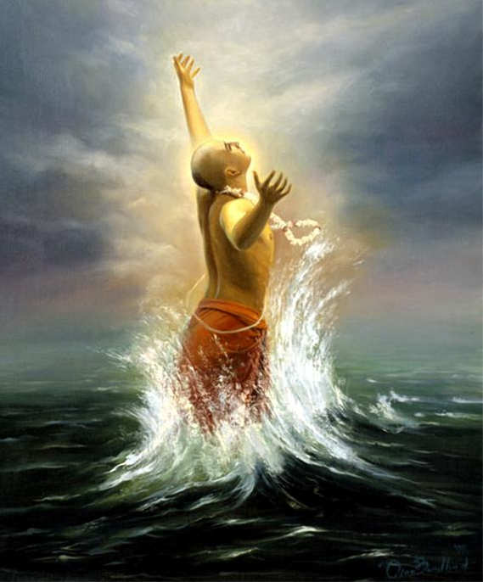
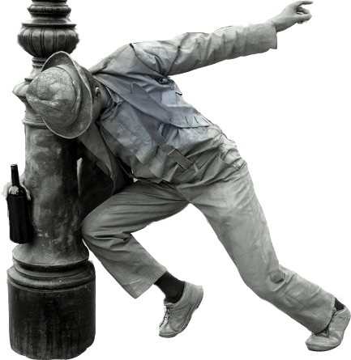
Notes:
If you see a drunkard and a high class bhakta, one may feel similar..
But they are not same..
One is the worst, and the other the best!

Slide 33
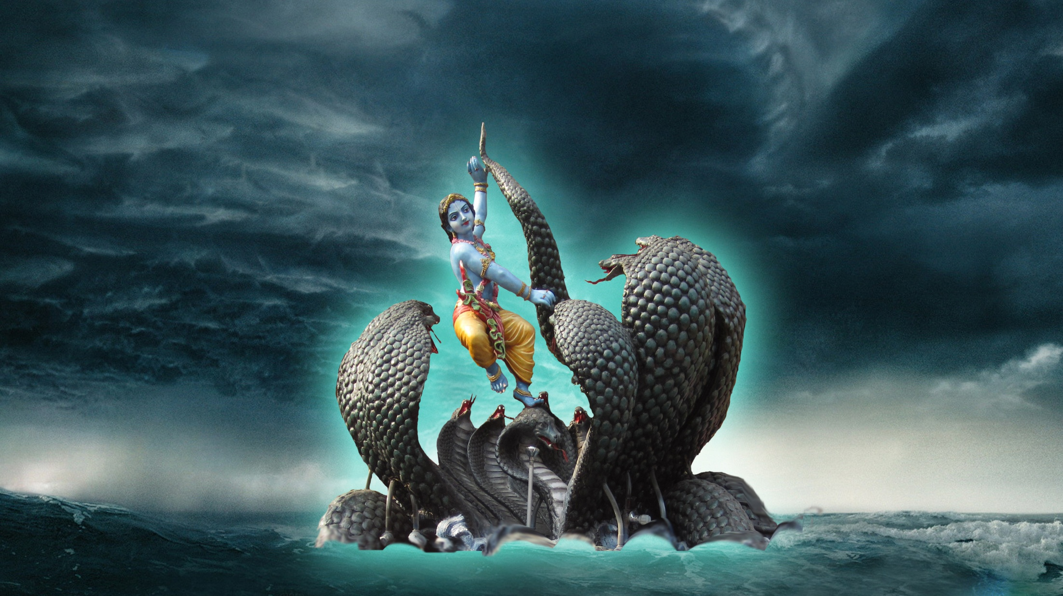
Seeing Krishna!

Slide 34
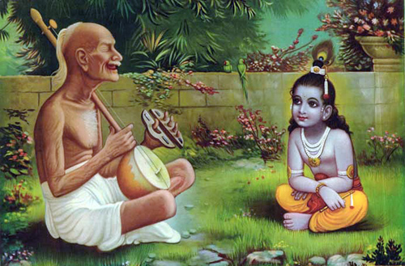

Slide 35
Sraddha – Faith
Sadhu-Sanga – Association wth devotees
Bhajana Kriya – Devotional Service
Anartha Nivrti – Throw unwanted attachments
Nistha – Steadiness
Ruci – Taste
Asakti – Devotional attachments
Bhava – Love
Prema – Pure love for Krishna

Slide 36
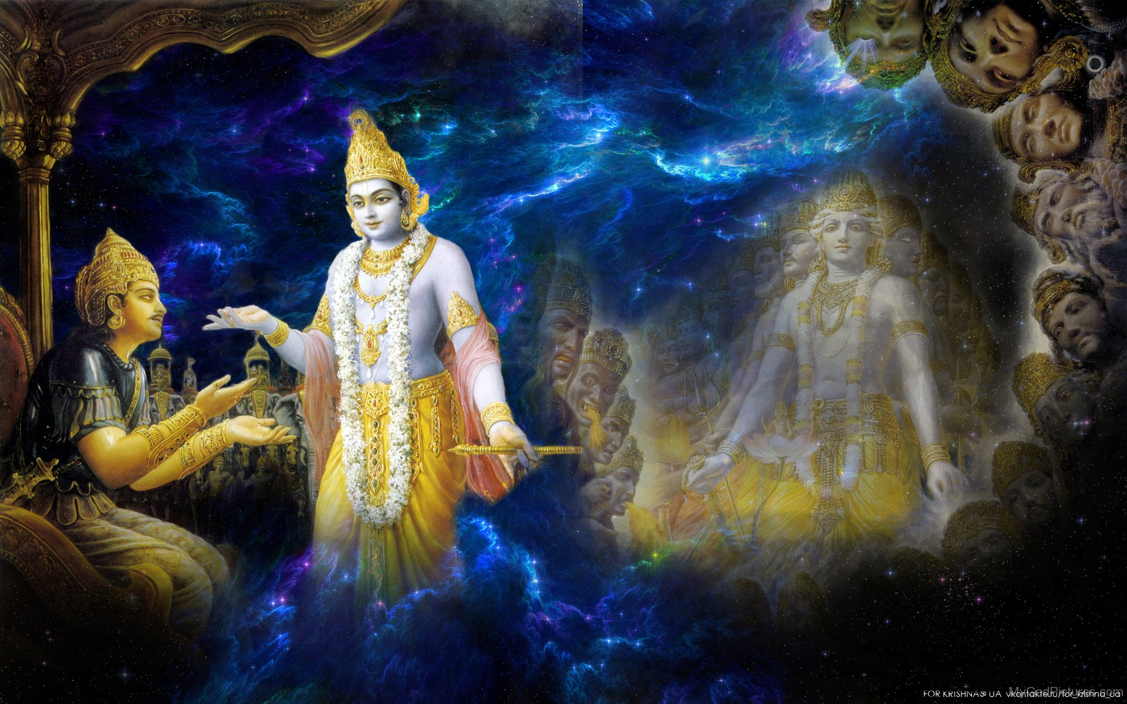
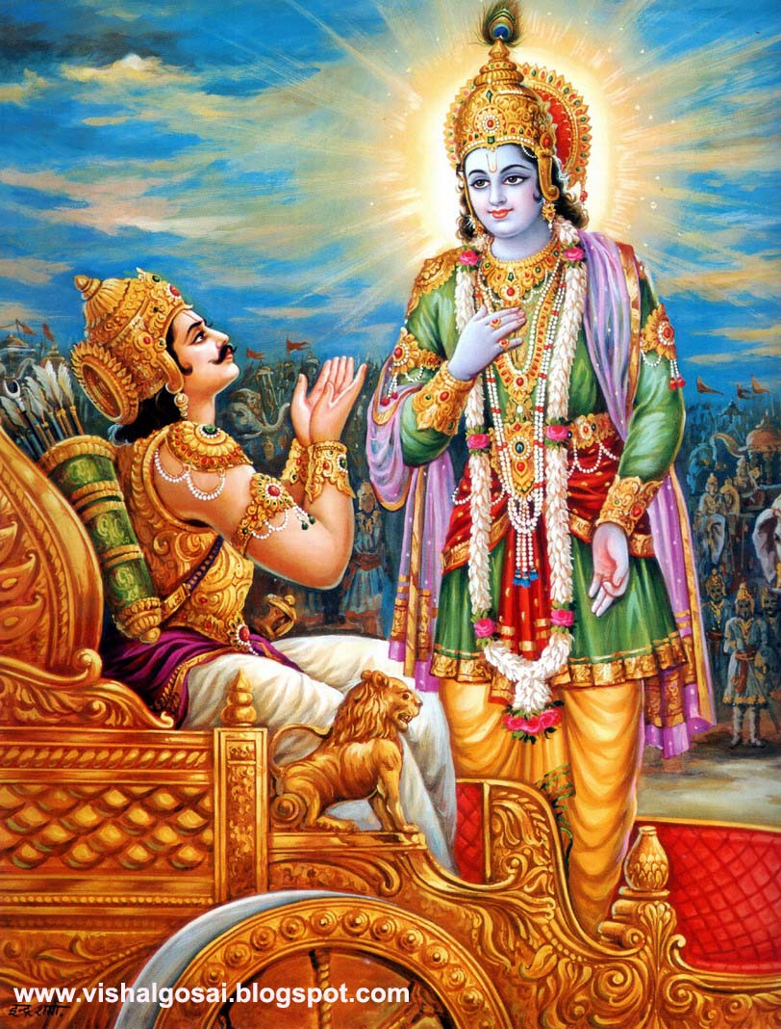
Notes:
Arjuna saw two types of visions..

Slide 37
Notes:
How does Krishna give His vision?

Slide 38
Notes:
Yogis see Him as Paramatma – just once after millions of years of penance!

Slide 39
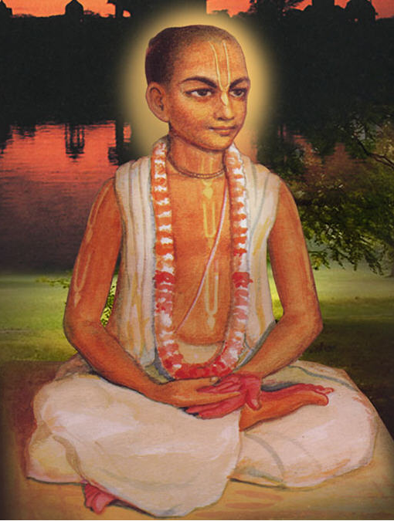
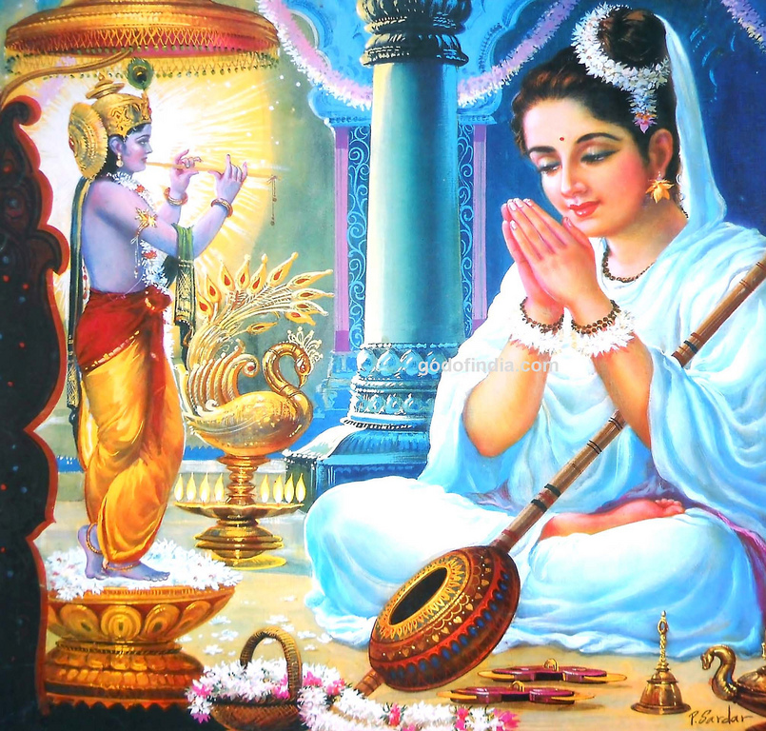
Notes:
Meerabai has seen several types of visions..

Slide 40
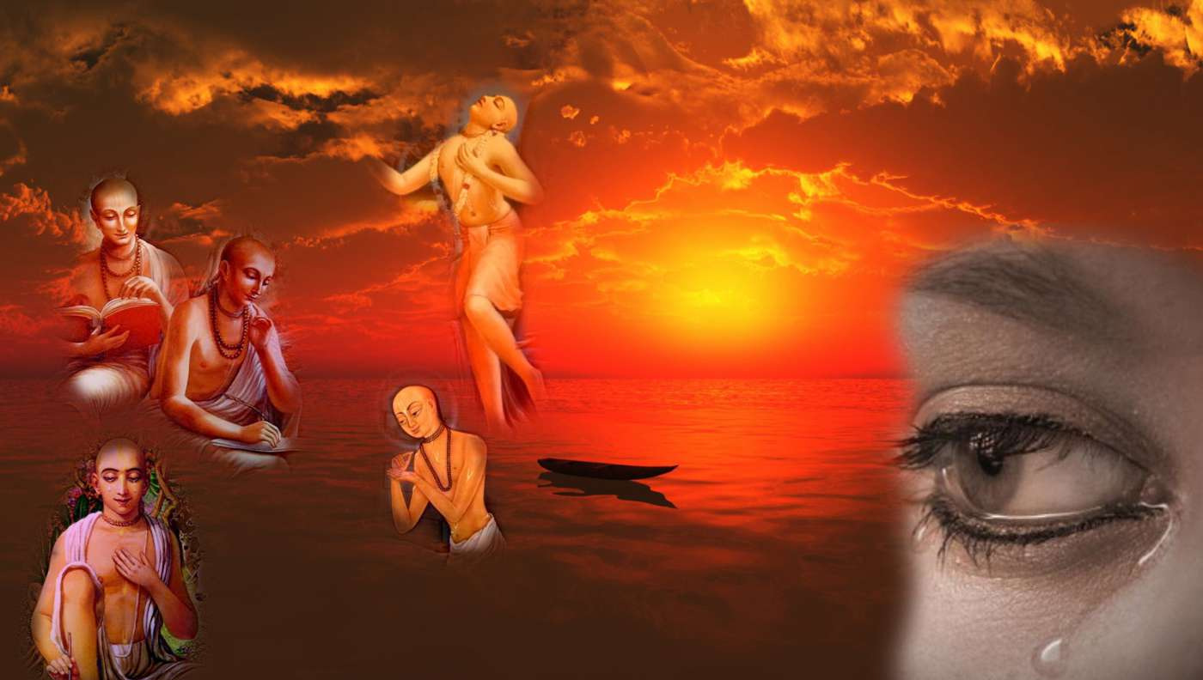
Notes:
How does Krishna give His vision?

Slide 41
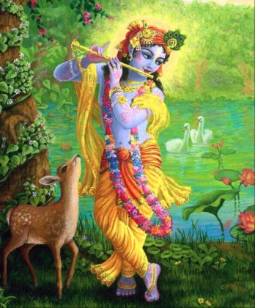
F-10
Gopi Nāthā! Gopi Nāthā!
Gokulvana Jana Gopi Nāthā!
Govindā Hari Gopi Nāthā
Gokula Mani Gopi Nāthā ... (Gopi)
Brahmā Mohita Gopi Nāthā
Brindā Sevita Gopi Nāthā
Braja Pālanā Gopi Nāthā
Prema Kāntanā Gopi Nāthā ... (Gopi)
Shyama Sundarā Gopi Nāthā
Shymali Mohanā Gopi Nāthā
SreegaNo Vatsa Gopi Nāthā
Sreedharā Nanda Gopi Nāthā ... (Gopi)
Kāliya Nartanā Gopi Nāthā
Kānchana Nesanā Gopi Nāthā
Govardana Dhara Gopi Nāthā
Krishnā Govindā Gopi Nāthā ... (Gopi)
śyāmam hiranya-paridhim vanamālya-barha-
dhātu-pravāla-nata-vesham anavratāmse
vinyasta-hastam itarena dhunānam abjam
karnotpalālaka-kapola-mukhābja-hāsam

Slide 42
QUESTIONS?
Notes:
Why Krishna and Balaram did not go to the yagya to see the Brahmins.
Ans: Their purpose of reciting vedas is not for devotion. Krishna is Vedesu Durlabham’
How come the brahmin ladies even though not thrice born could see Krishna?
Ans: Adurlabham atma bhaktau!
Qn: Should a real devotee listen to Krishna’s advice, or listen to the advise of His devotees?
Ans: Listen to His bhaktas only. Follow the advise of Gopis.
Qn: Why the brahmins coud not see Krishna and balaram? Give real intelligent answer..
Ans: Vedic brahmins cannot attain Krishna and balaram. they can attain vaikuntha Narayana or Visnu but not Krishna!
Qn: Tell the difference between ‘Vedesu Durlabham, and ‘ Nigama Pratithai Stuvanti’
Ans: First one is a non-devotee, the second one is about devotee (Bhaava Bhaavita)
Qn: Imagine and tell as what kind of ‘rupa mahima asana yaana bhusaa’ of a gopa?
Ans:
Qn: Imagine and tell what kind of ‘rupa mahima asana yaana bhusaa’ of Indra?
Ans:
Qn: Is taking initiation but not following guru’s instruction makes one a real bhakta?
Ans:

Slide 43
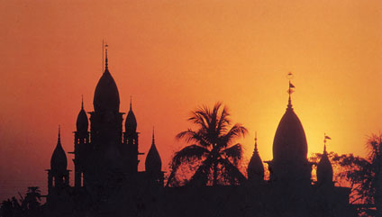
Thank You!
Hare Krishna!

